Slide 1
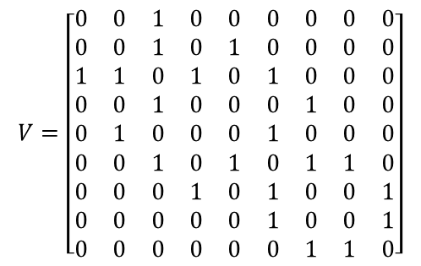
$$V=\left[\begin{matrix}0 & 0 & 1 & 0 & 0 & 0 & 0 & 0 & 0 \\ 0 & 0 & 1 & 0 & 1 & 0 & 0 & 0 & 0 \\ 1 & 1 & 0 & 1 & 0 & 1 & 0 & 0 & 0 \\ 0 & 0 & 1 & 0 & 0 & 0 & 1 & 0 & 0 \\ 0 & 1 & 0 & 0 & 0 & 1 & 0 & 0 & 0 \\ 0 & 0 & 1 & 0 & 1 & 0 & 1 & 1 & 0 \\ 0 & 0 & 0 & 1 & 0 & 1 & 0 & 0 & 1 \\ 0 & 0 & 0 & 0 & 0 & 1 & 0 & 0 & 1 \\ 0 & 0 & 0 & 0 & 0 & 0 & 1 & 1 & 0\end{matrix}\right]$$
Volume Adjacency (Edges)
Node 2
Node 5
Model Volume (Nodes)
Node 1
Node 3
Node 6
Node 8
Node 4
Node 7
Node 9

Slide 2

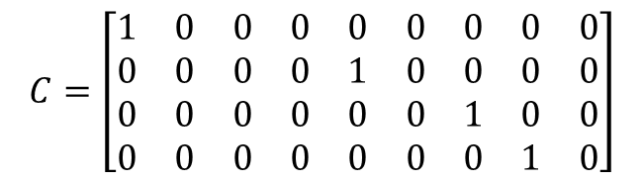
Vessel network, $V$
Component
Node 2
Node 5
2
Node 1
Node 3
Node 6
Node 8
1
4
Node 4
Node 7
Node 9
3
$$C=\left[\begin{matrix}1 & 0 & 0 & 0 & 0 & 0 & 0 & 0 & 0 \\ 0 & 0 & 0 & 0 & 1 & 0 & 0 & 0 & 0 \\ 0 & 0 & 0 & 0 & 0 & 0 & 1 & 0 & 0 \\ 0 & 0 & 0 & 0 & 0 & 0 & 0 & 1 & 0\end{matrix}\right]$$

Slide 3
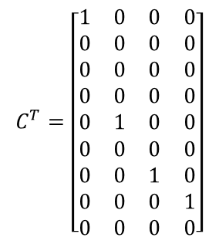
Node 2
Component
$$C^{T}=\left[\begin{matrix}1 & 0 & 0 & 0 \\ 0 & 0 & 0 & 0 \\ 0 & 0 & 0 & 0 \\ 0 & 0 & 0 & 0 \\ 0 & 1 & 0 & 0 \\ 0 & 0 & 0 & 0 \\ 0 & 0 & 1 & 0 \\ 0 & 0 & 0 & 1 \\ 0 & 0 & 0 & 0\end{matrix}\right]$$
Node 5
2
Node 1
Node 3
Node 6
Node 8
1
4
Node 4
Node 7
Node 9
3

Slide 4


Vessel network, $V$
Distribution System $D_{1}$
Distribution System $D_{2}$
Notes:
System of Systems

Slide 5
Vessel network and components
Component
Distribution System $D_{1}$
Distribution System $D_{2}$
Not included in system
Not included in system
Notes:
System of Systems

Slide 6










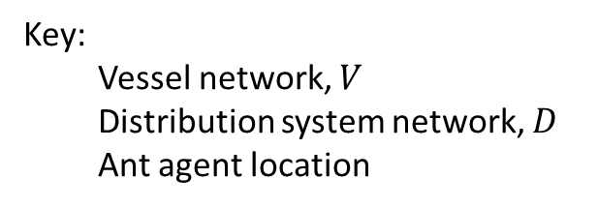



Key:
Vessel network, $V$
Distribution system network, $D$
Ant agent location
1) Starting network
$$j$$
$$k$$
2) Start edge addition
2a) Choose number of branches, $T\left(b_{i}\right)$
2b) Create list of possible edges:
$$l=[\left(i,j\right),\left(i,k\right),\left(i,l\right)]$$
2c) For each branch:
Get pheromones $τ_{i}$ for edges in $l$
Add edge and corresponding node chosen by $T(τ_{i})$
Remove chosen edge from $l$
2d) Example network after edge and node addition:
$$i$$
$$l$$
3) Initialize ant agents at added nodes
$$j$$
$$j$$
$$k$$
$$k$$
$$i$$
$$l$$
$$i$$
$$l$$
Notes:
Ant step

Slide 7



Vessel network $V$
System $1$ network, $S_{1}$
System $2$ network, $S_{2}$
Notes:
System of Systems

